Slide 1
Selfish, Stubborn & GHOST Mining
Mohammed Z. Guniem & ESSANDOH RAYMOND

Slide 2
Blockchain Mining
3 main constraints:
- Mining Power.
- Network Power.
- Number of miners.
Simulation environment
- 100 miners in total.
- Total mining power of 100
- Total network power of 100

Slide 3
Analysis of mining power Simulation nr. 1 - Setup
Studying the effect of an increasing mining power of just one selfish miner.
Having:
- 100 in total mining power and 100 miners.
- 99 honest miners
- 1 selfish miner
- Network power is random in case of blockchain forks.
We start the selfish mining power at 0% and the honest mining power at 100%.
We run the simulation for 60 steps, and at each step:
- Increasing the selfish mining power by 1.
- Decreasing the honest mining power by 1.

Slide 4
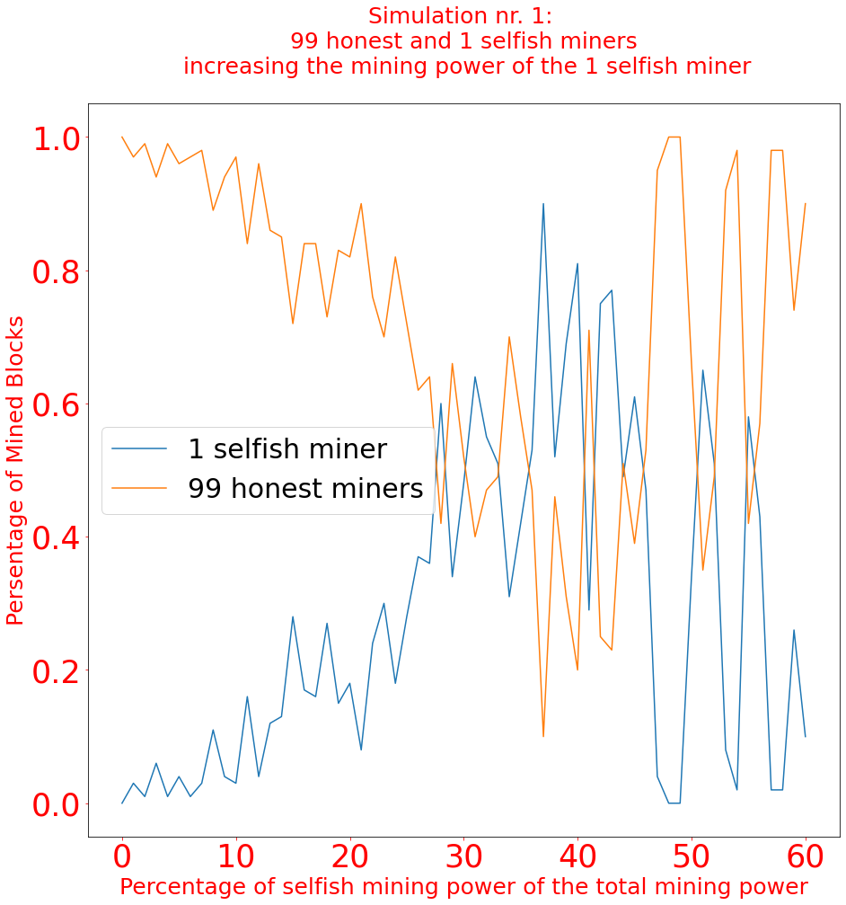
Analysis of mining power Simulation nr. 1 – Results & Analysis
< 25% selfish mining power:
- Total selfish profit is more likely to be less than total honest profit
>= 25% selfish mining power:
- Profit of the selfish miner is highly competitive with the total honest profit generated by the other 99 honest miners.
But does that mean selfish mining is a good strategy?
- 1 selfish miner was able to claim from 0% to 40% of total profit for a mining power less than 25%.

Slide 5
Analysis of mining power Simulation nr. 2 - Setup
Studying the effect of an increasing number of selfish miners where all individual honest and selfish miners have equal mining power.
Having:
- 100 in total mining power and 100 miners.
- Every miner always has an equal power of 1.
- Network power is random in case of blockchain forks.
We start the selfish mining power at 0% (0 selfish miners)
And the honest mining power at 100% (100 honest miners).
We run the simulation for 60 steps, and at each step:
- Increasing the selfish mining power by increasing the number of selfish miners by 1.
- Decreasing the honest mining power by decreasing the number of honest miners by 1.

Slide 6
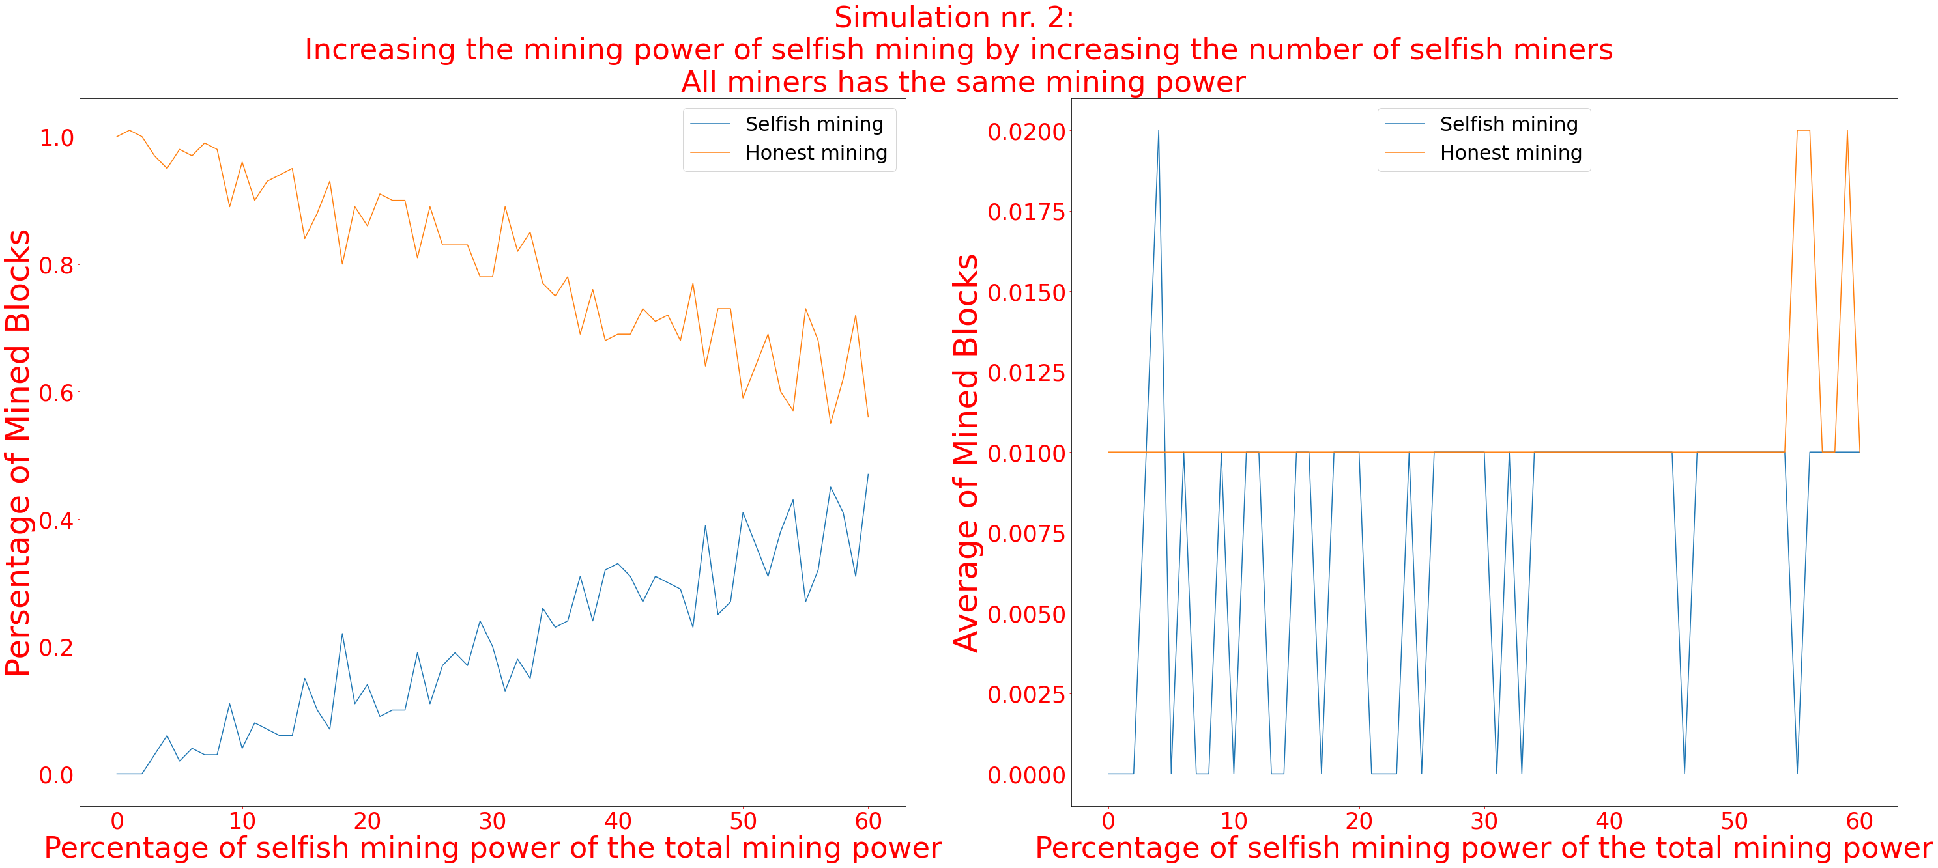
Analysis of mining power Simulation nr. 2 – Results & Analysis
From 0% (0 selfish miners) to 60% (60 selfish miners) selfish mining power
- Increasing selfish profit
From 100% (100 honest miners) to 40% (40 honest miners) honest mining power
- Decreasing honest profit
Stable average profit of an honest miner at 0.01%.
- Good/Fair distribution of profit among miners.
Instable average profit of a selfish miner mostly between 0% and 0.01%.
- Unfair distribution of profit among selfish miners.

